Slide 1
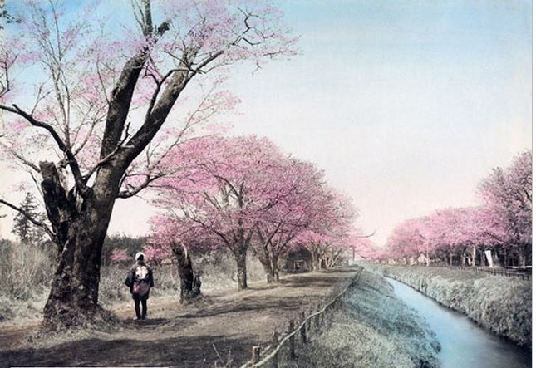

Slide 2
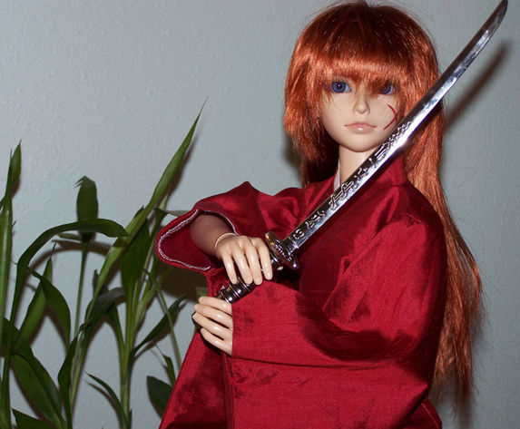
Soft as the rustle of silk
Sharp as the keening of cold steel
Your story found its way into my life

Slide 3

In your time, in your place, the world was changing
The fabric of life was ripped in two

Slide 4
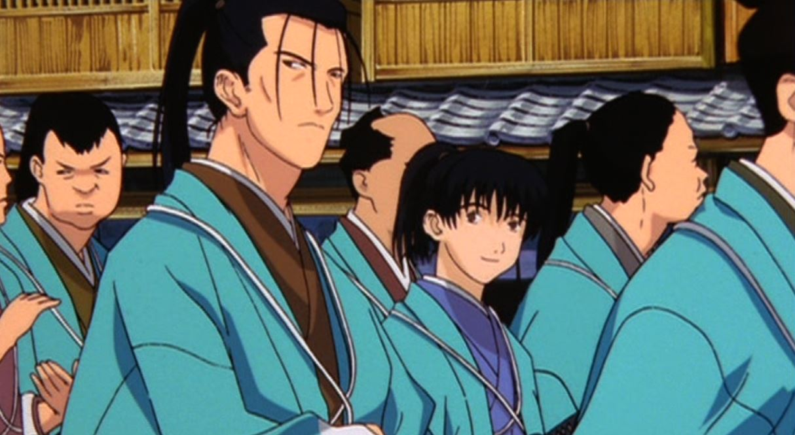
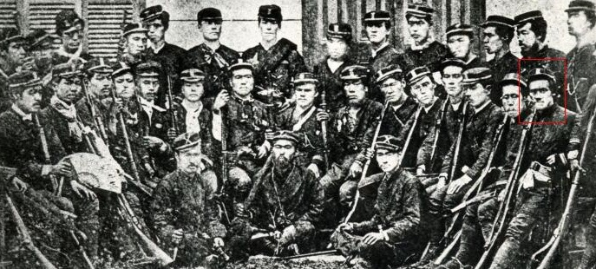
Some men fought for the power that existed

Slide 5
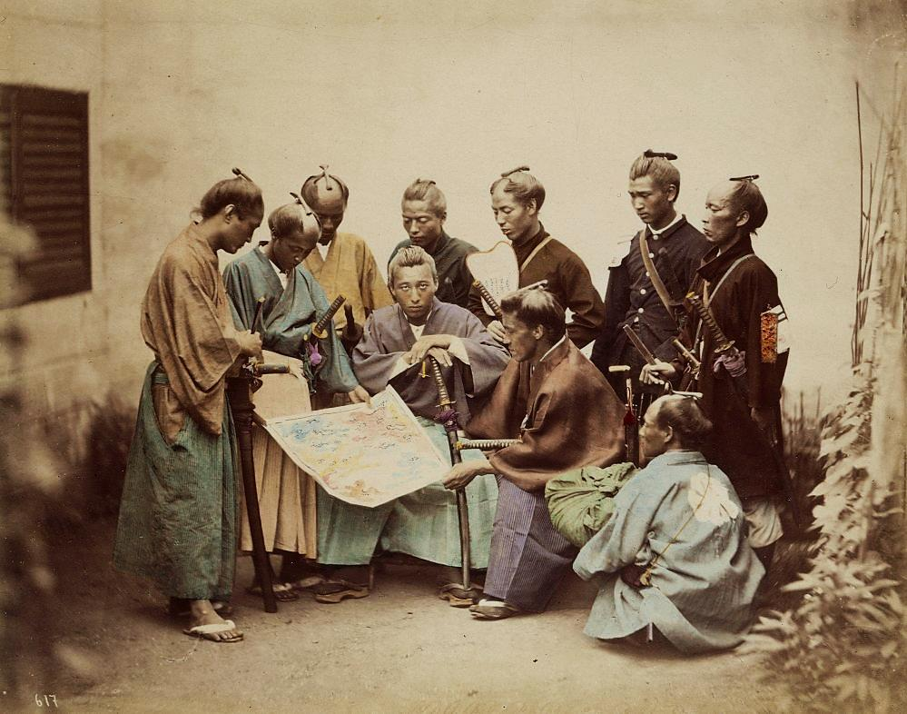
Other men sought to tear away the old to create something new

Slide 6
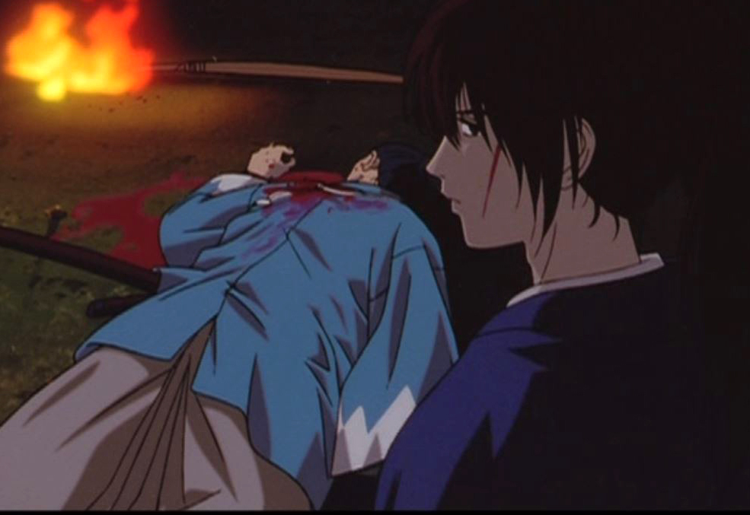
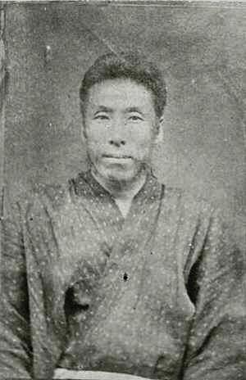
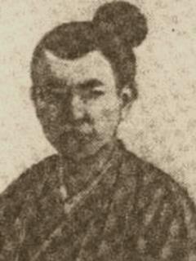
Some became manslayers, doing the horrendous work of others

Slide 7
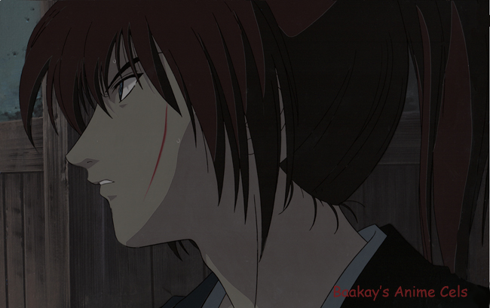
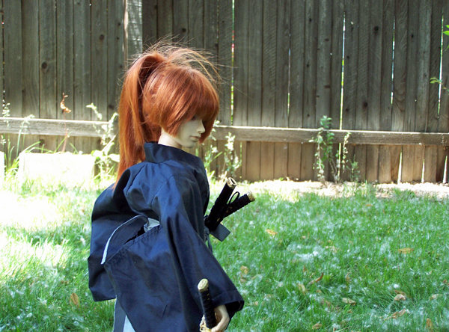
And you were one of these men, doing the wrong things for the right reasons
Or so you believed.

Slide 8
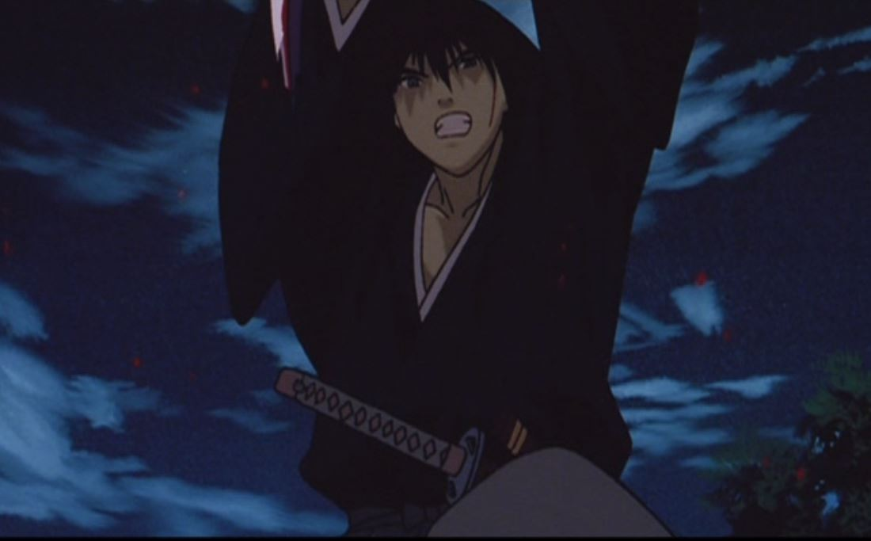
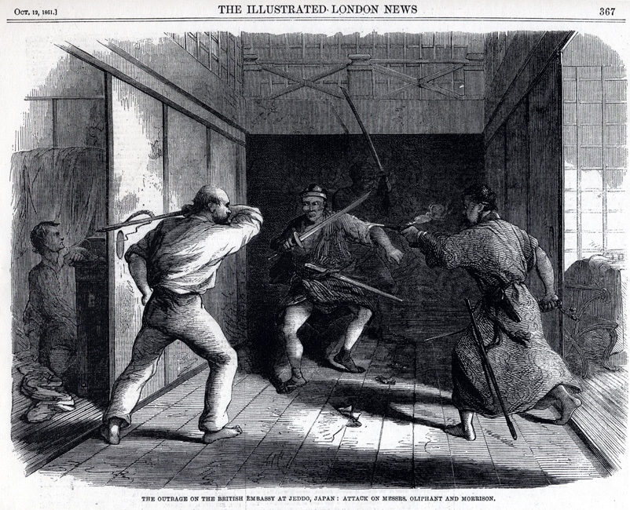
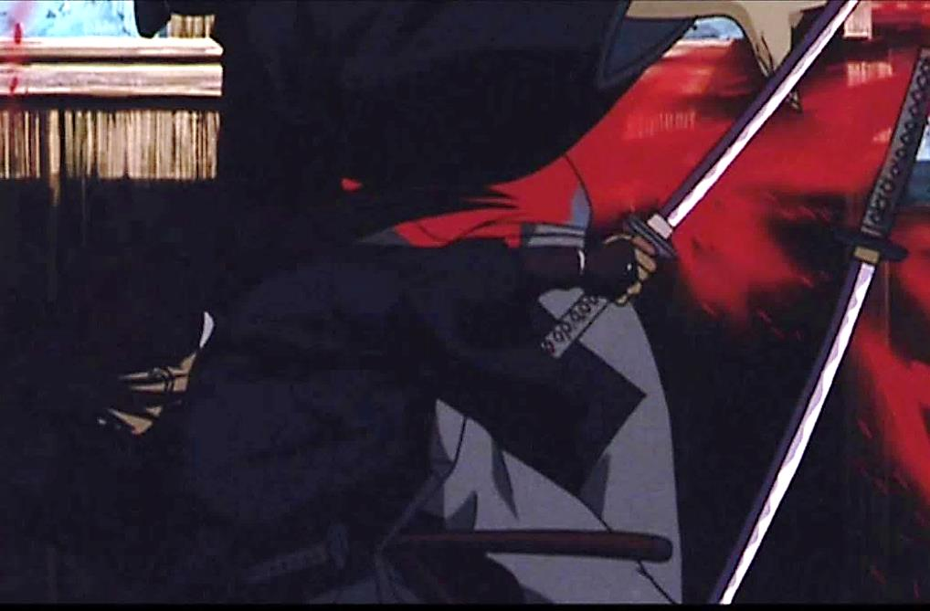
Terrible things were done in the name of a higher purpose

Slide 9
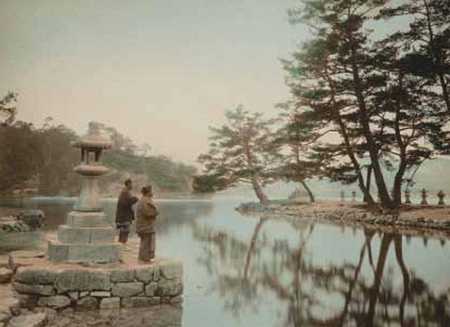
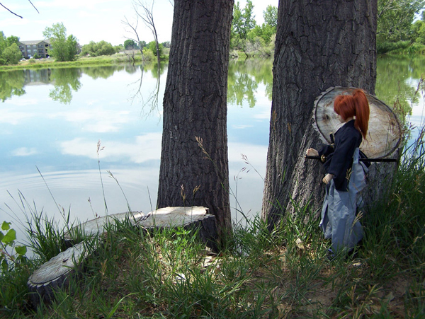
For the possibility that the people could live in peace

Slide 10
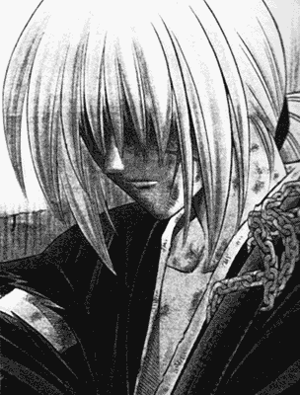
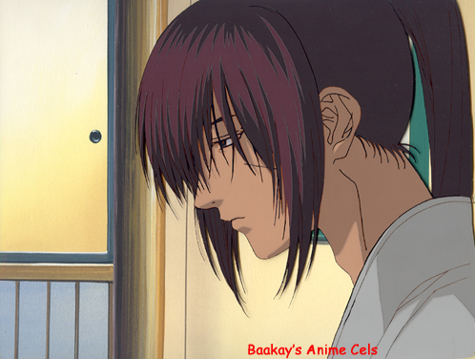
But terrible deeds can lead to great loss
and great grief

Slide 11
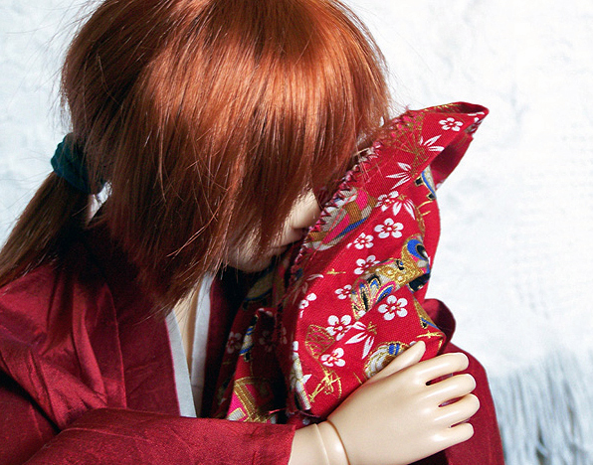
To mourning and regret

Slide 12
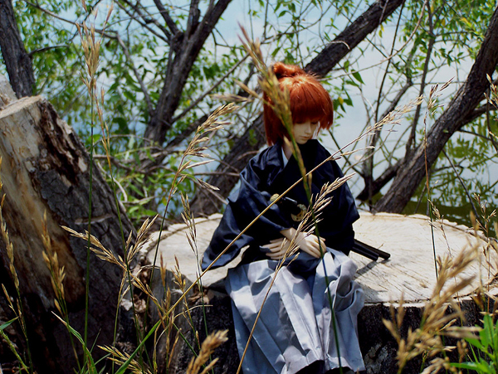
To great sadness and self doubt

Slide 13
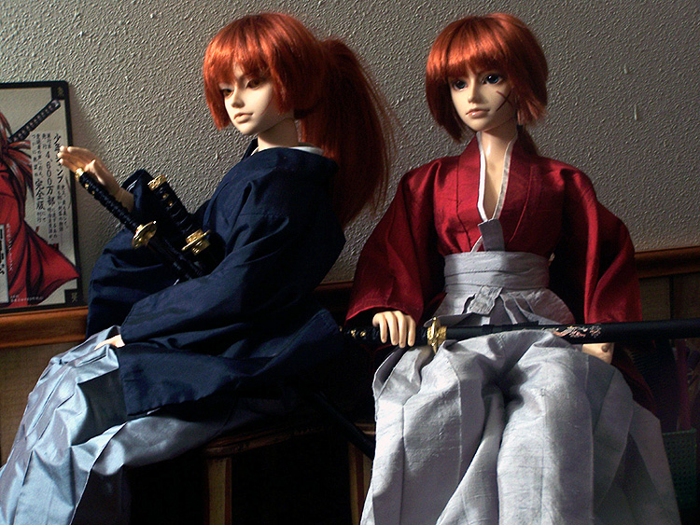
To the rending of a soul.

Slide 14
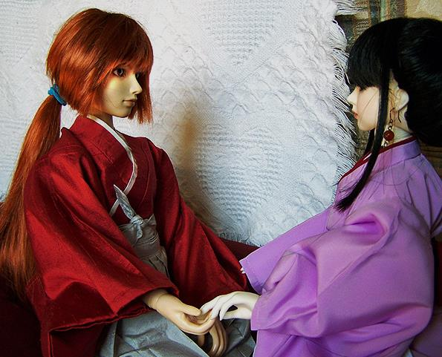
But this you have shown me –
what once was lost can be found

Slide 15
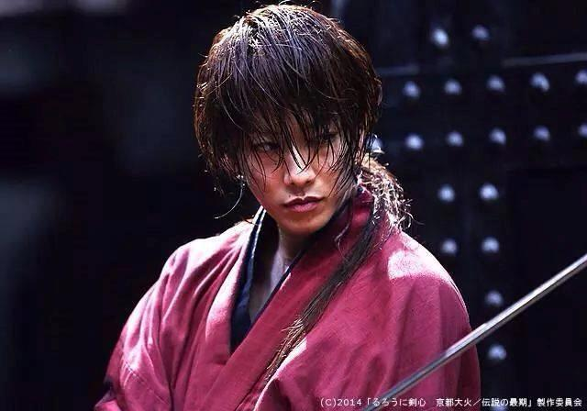
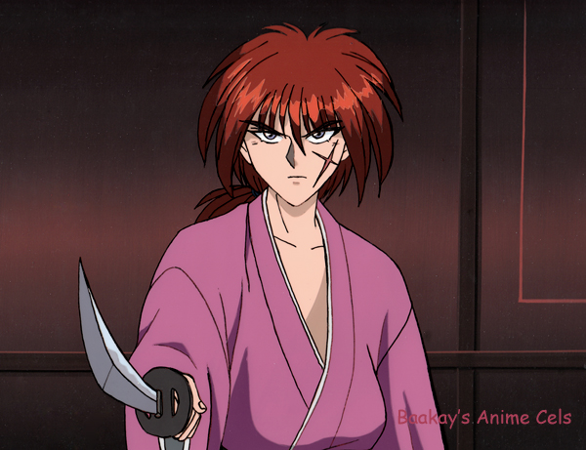
Great power can still be used to further great purposes

Slide 16
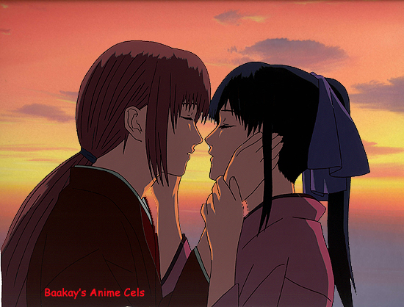
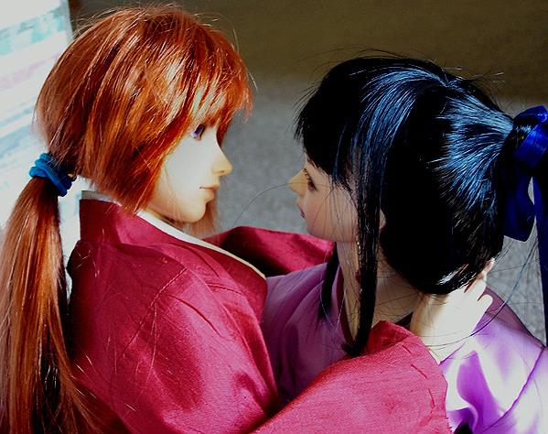
Even the fallen can be redeemed.

Slide 17
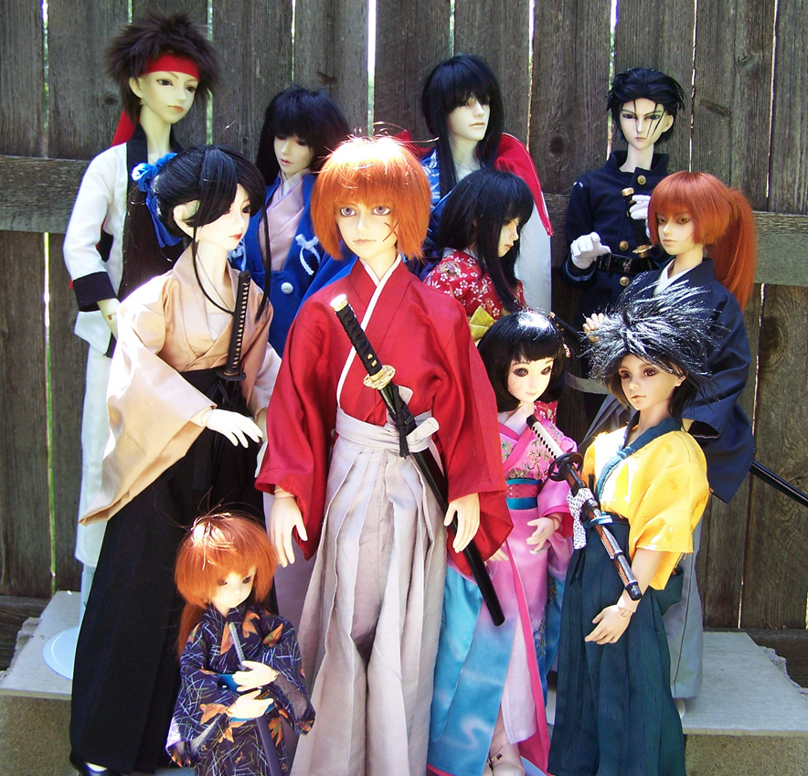
“With a sword, this one can protect those around him”

Slide 18
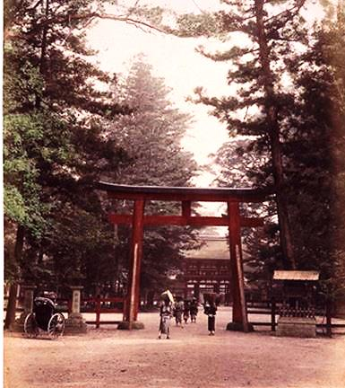
Like the rustle of silk
Like the keening of cold steel
Like a prayer

Slide 19
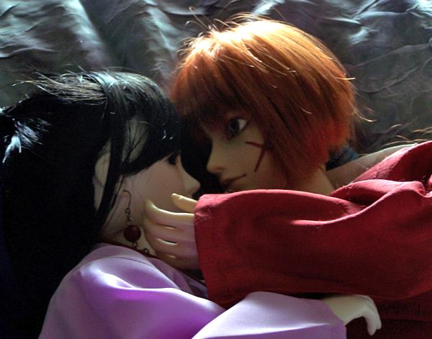
You will always be a part of me.

